Slide 1

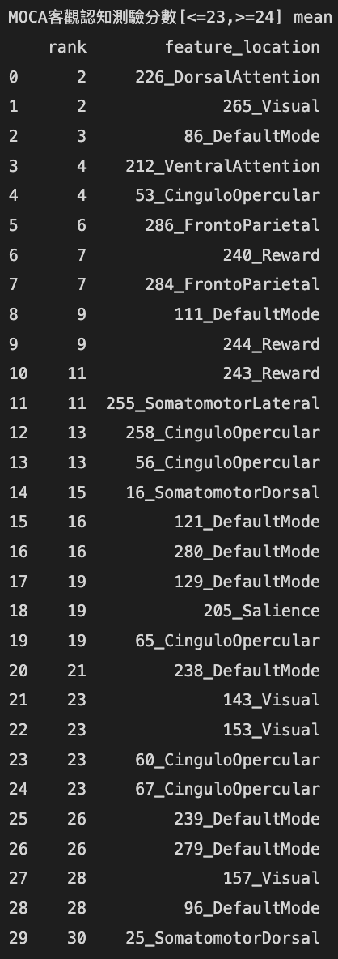
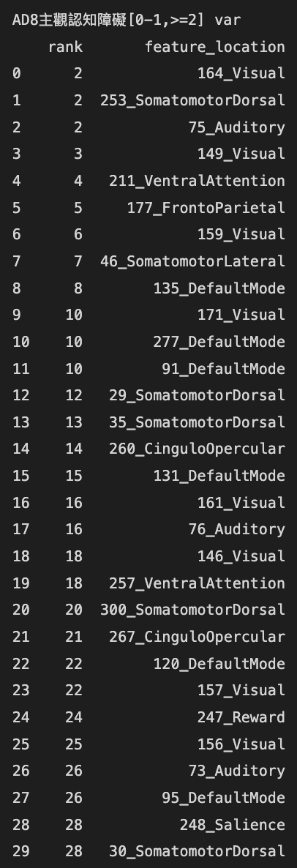
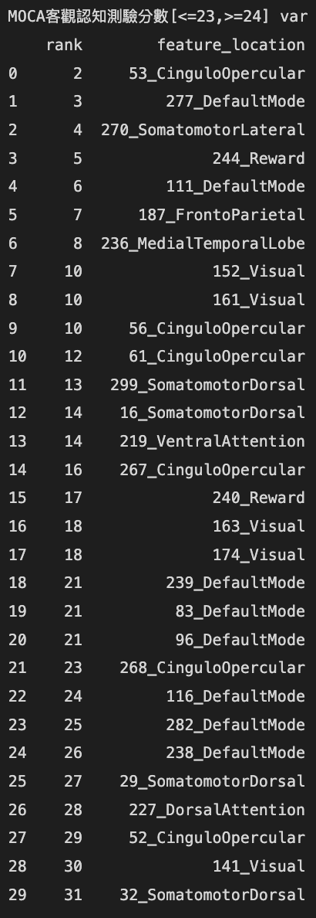
Python Bourta – ALFF overall Feature Selection

Slide 2

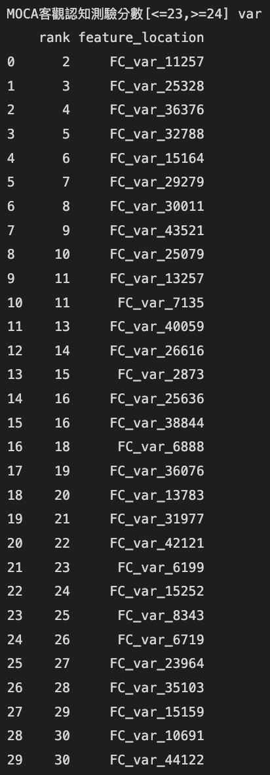

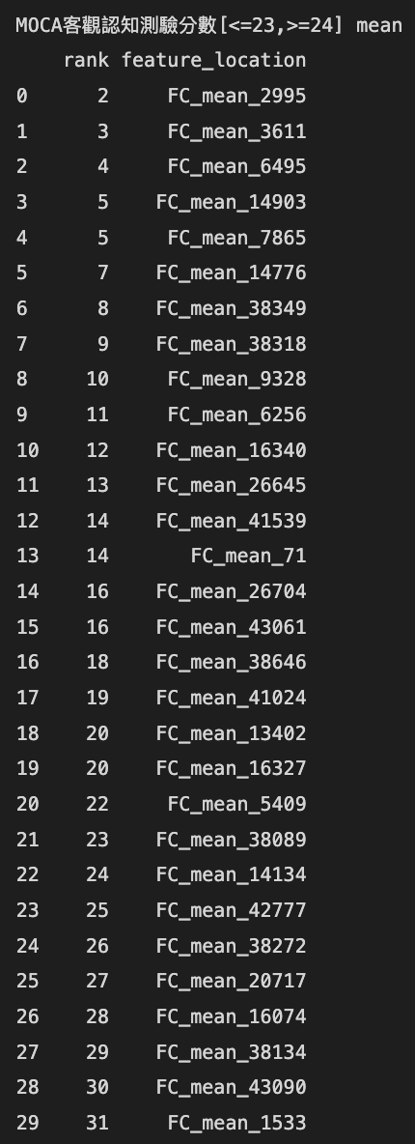
Python Bourta – FC overall Feature Selection

Slide 3

Cluster Analysis - algorithm
K-mean
Hierarchical

